Slide 1
Lab Analyses of Olivine-Carbonate Mixtures as observed on Mars
By Hope Wetzstein
Mentors: Mark Salvatore and Christopher Edwards

Slide 2
Background
The Mars Perseverance Rover in Jezero Crater
The Mars Spirit Rover in Gusev Crater
The different grain sizes

Slide 3
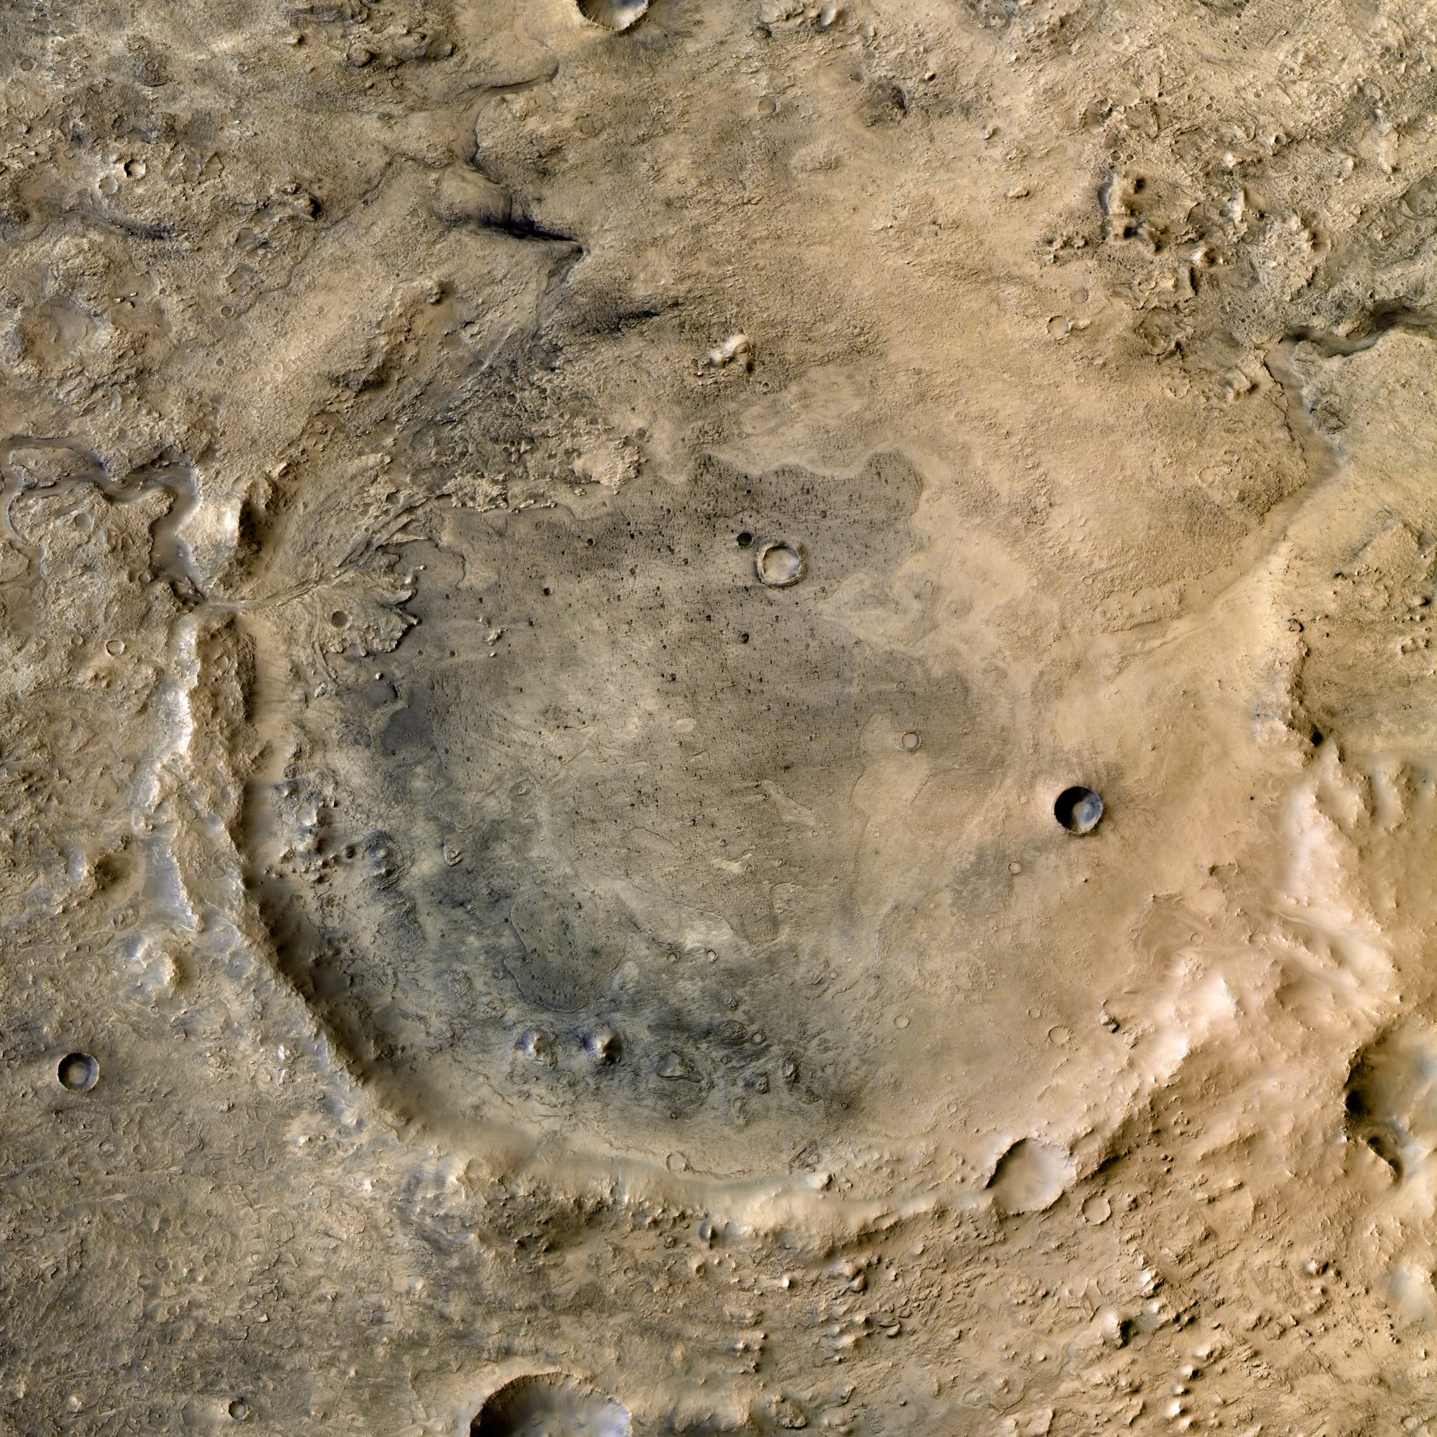
Research and
Purpose
Laboratory measurements of olivine and carbonate mixtures
Create a new suite of library spectra for current and future comparison of olivine and carbonate

Slide 4
Methods
Visible Near-Infrared (VNIR) Spectrometer
Fourier-Transform Infrared (FTIR) Spectrometer
Mid-Infrared (MIR)
Forward looking Infrared (FLIR) Camera
Prepare mixtures
Generate high-quality laboratory spectra

Slide 5
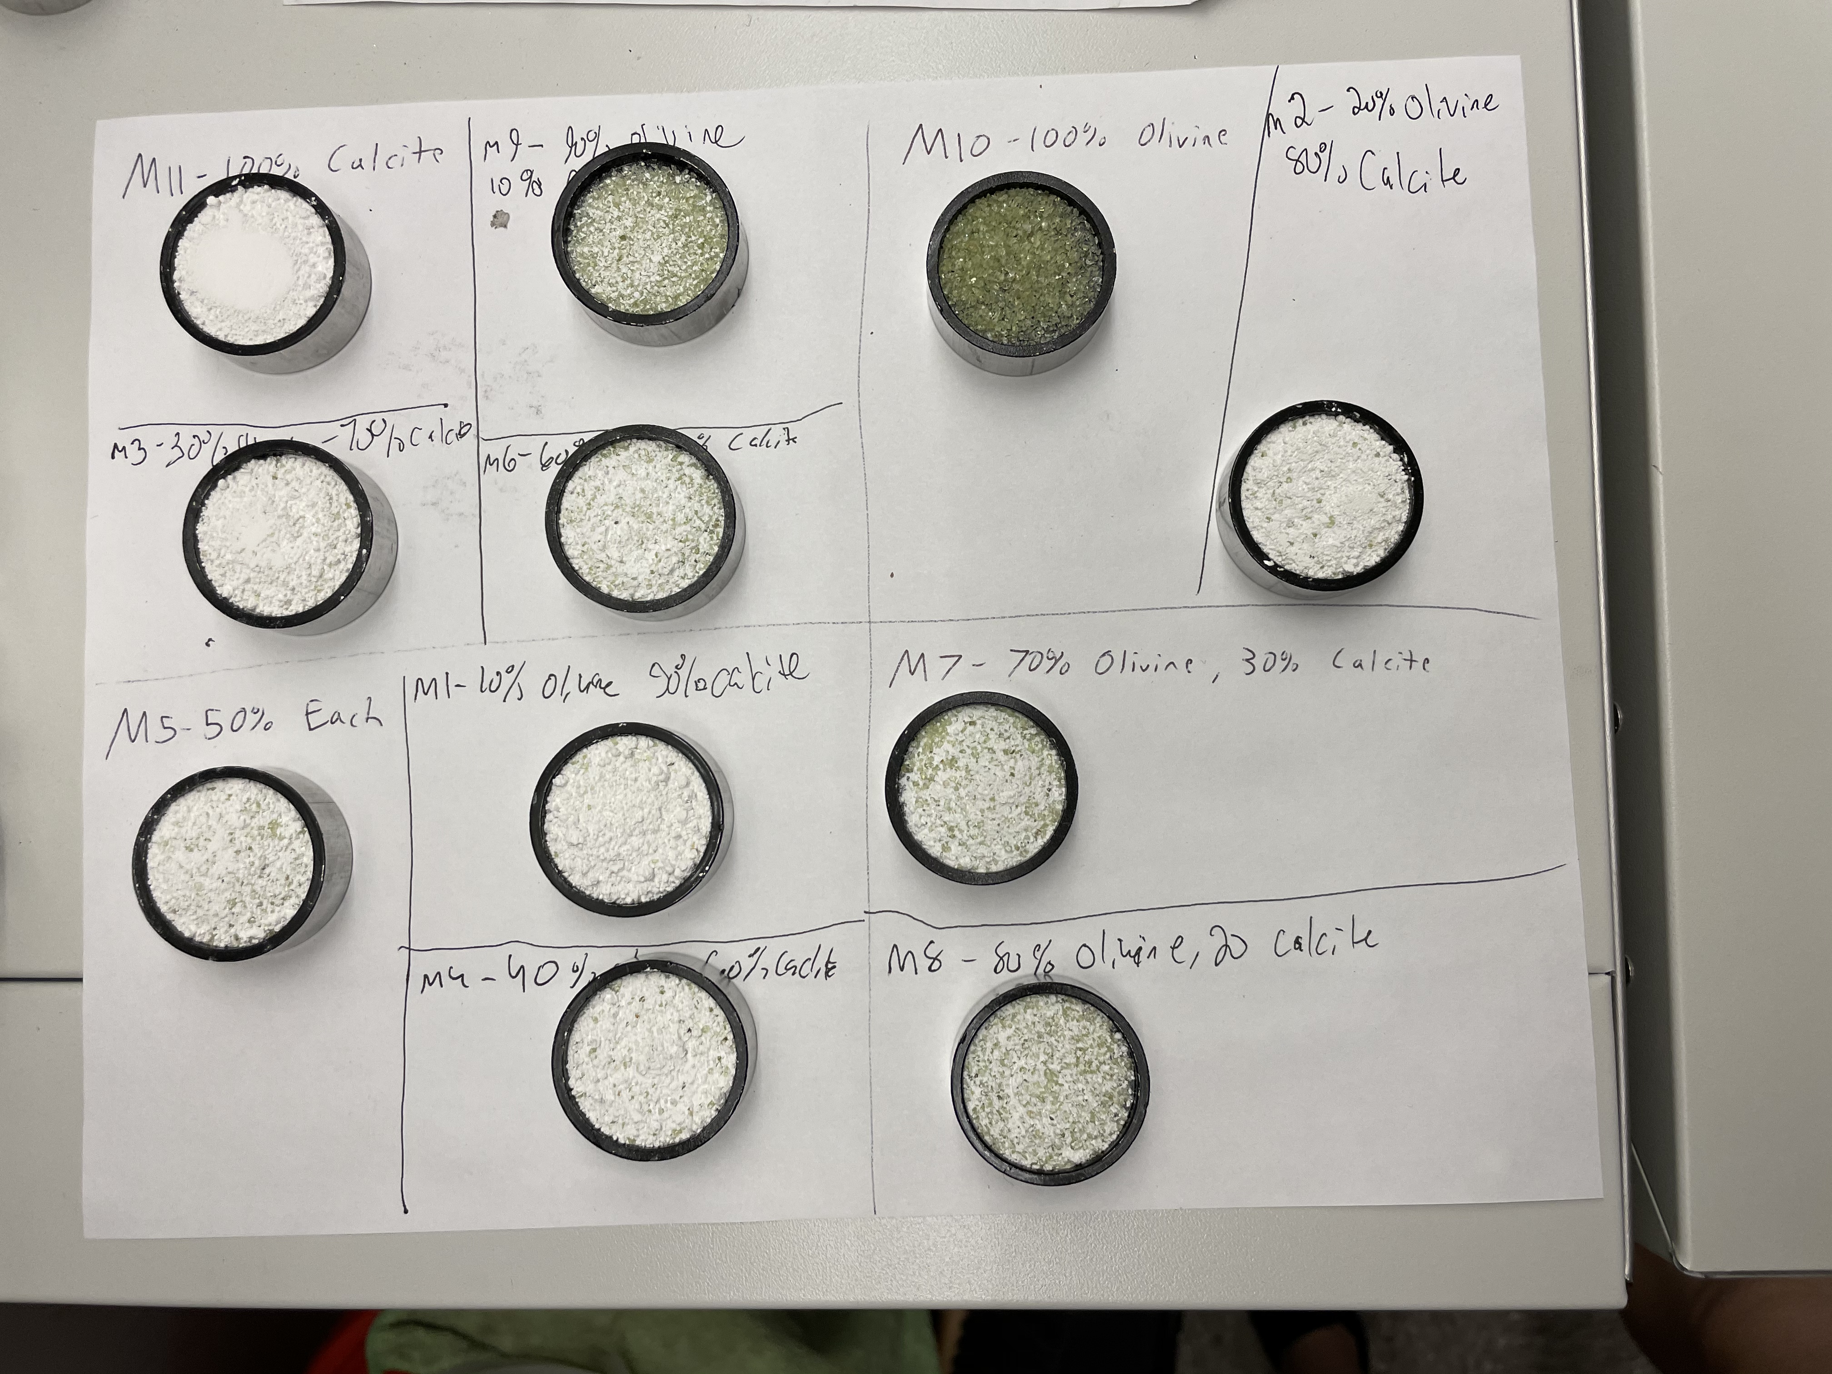

Slide 6
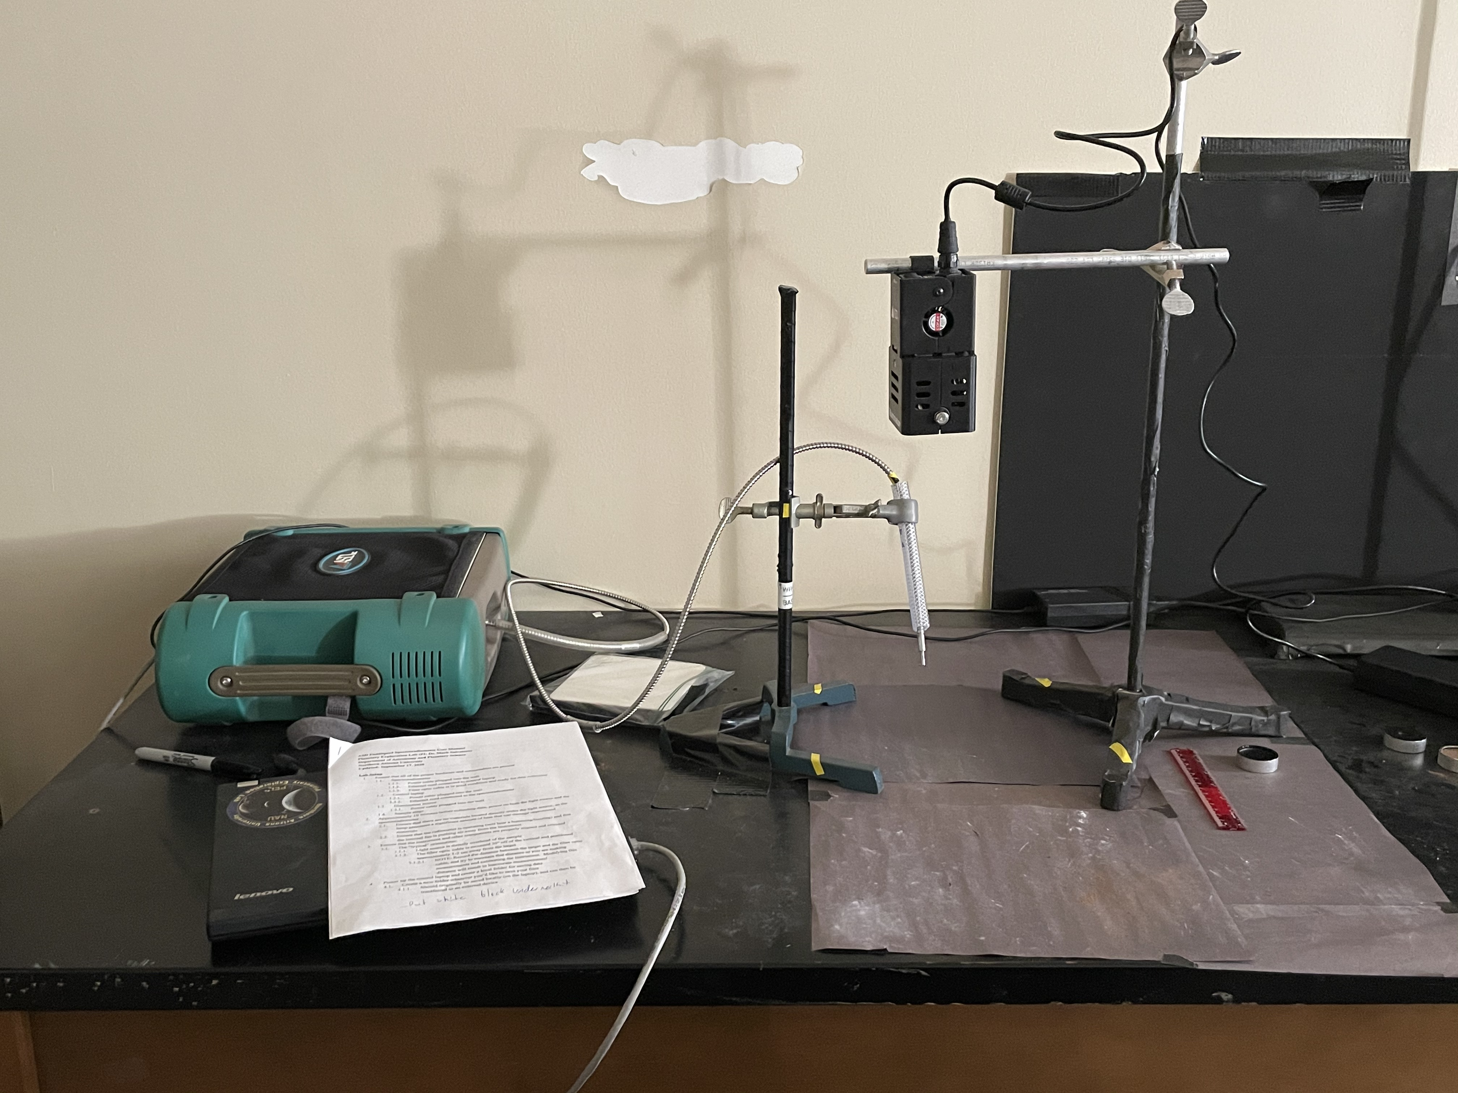
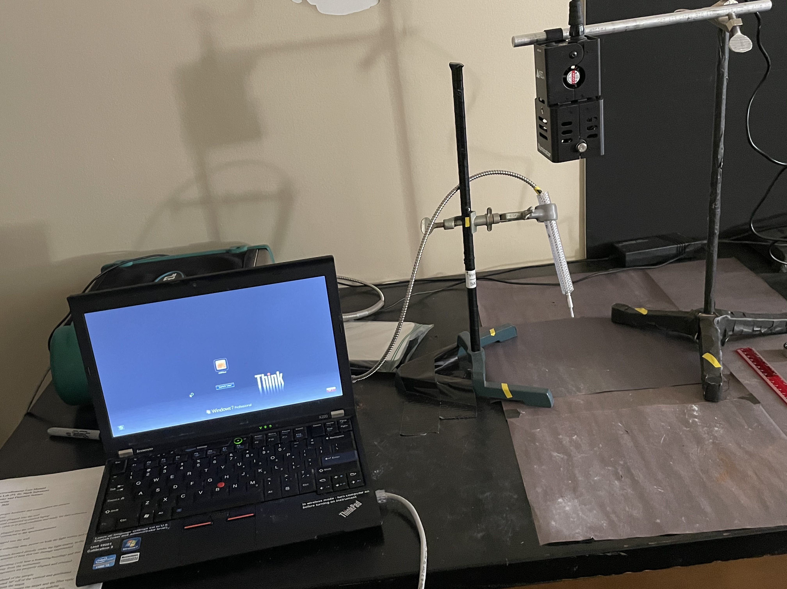
Photos of near infrared spectrometer

Slide 7
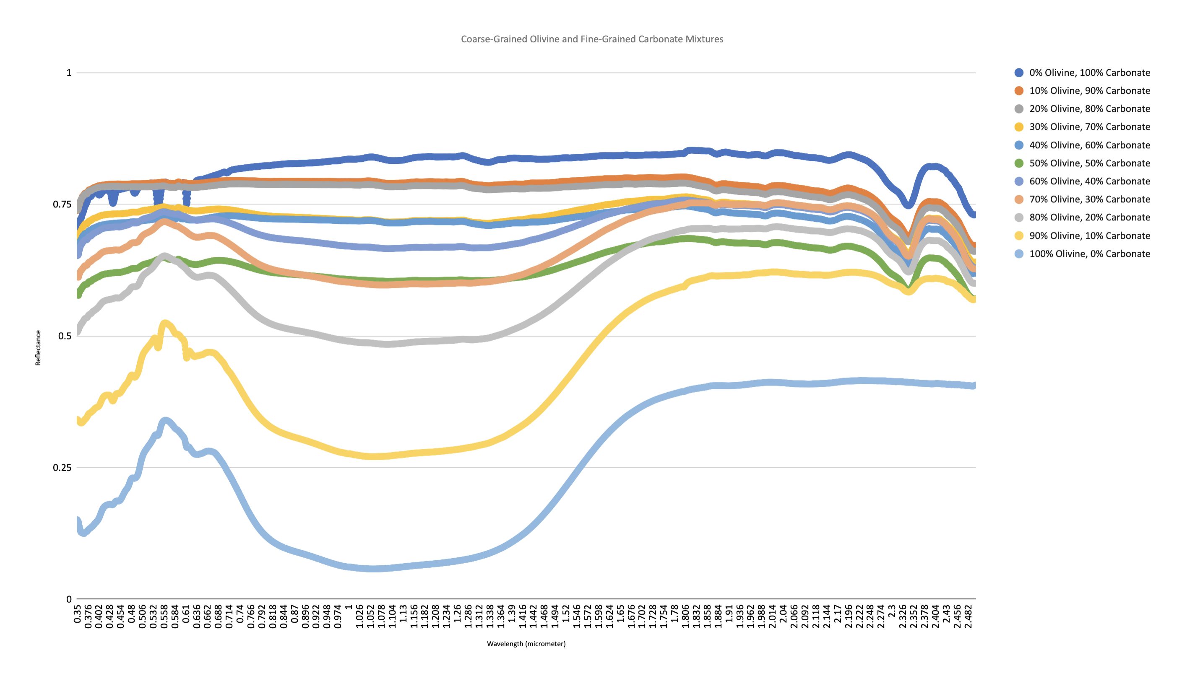

Slide 8
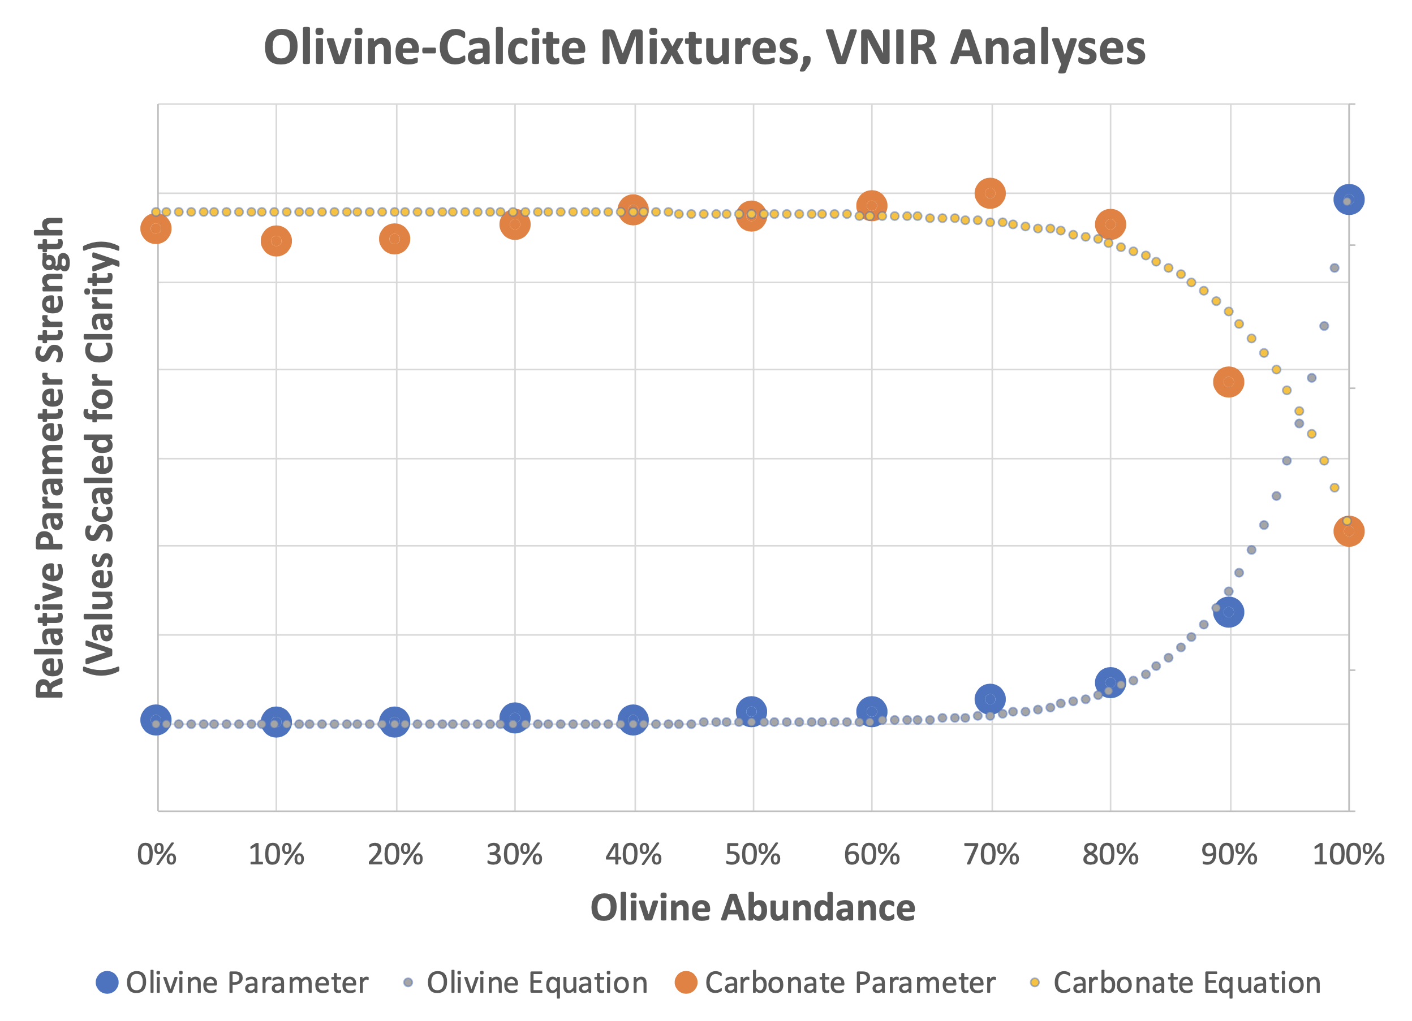

Slide 9
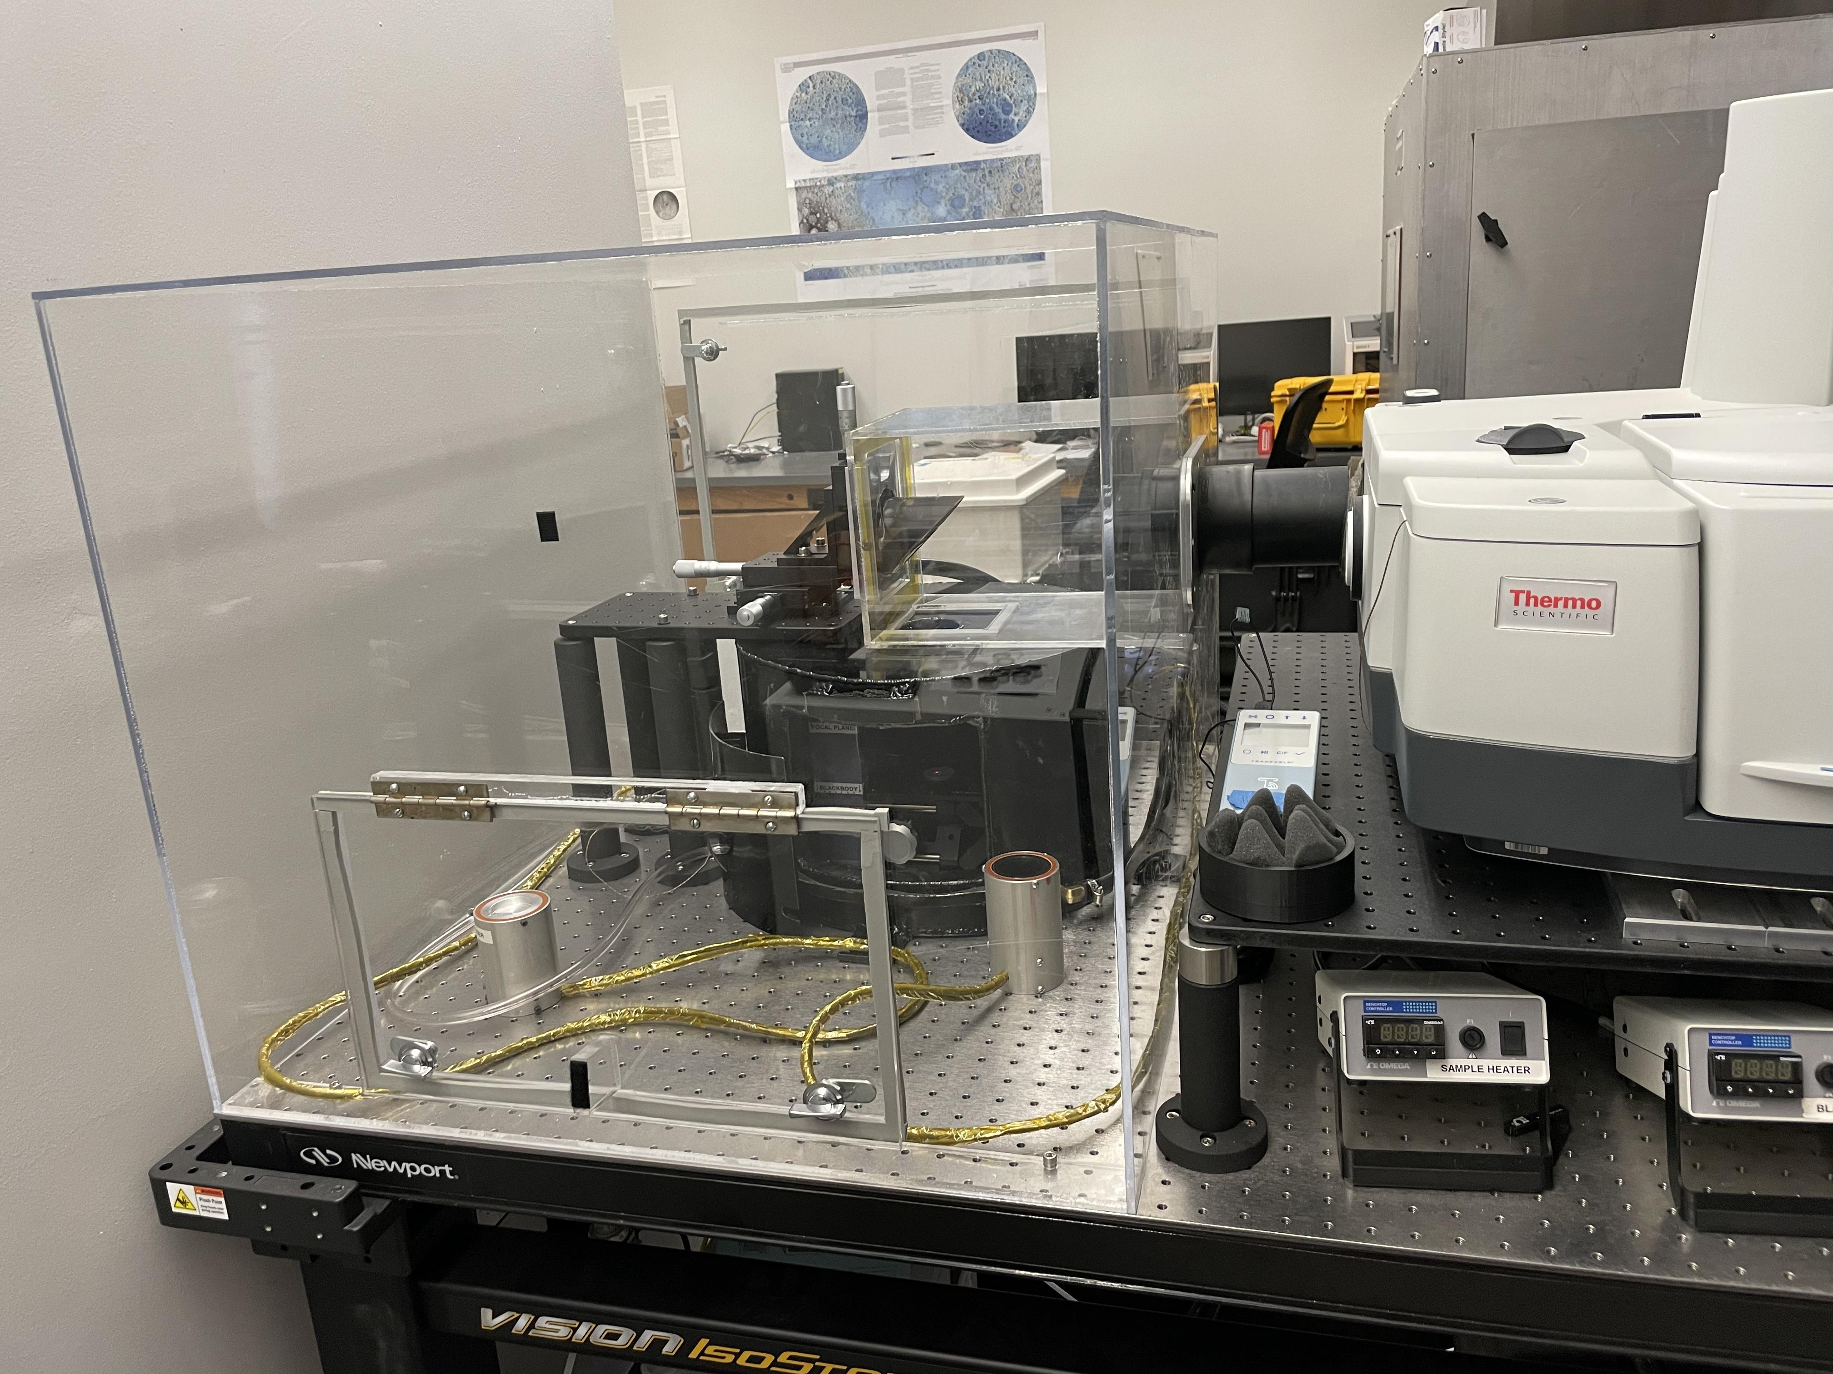
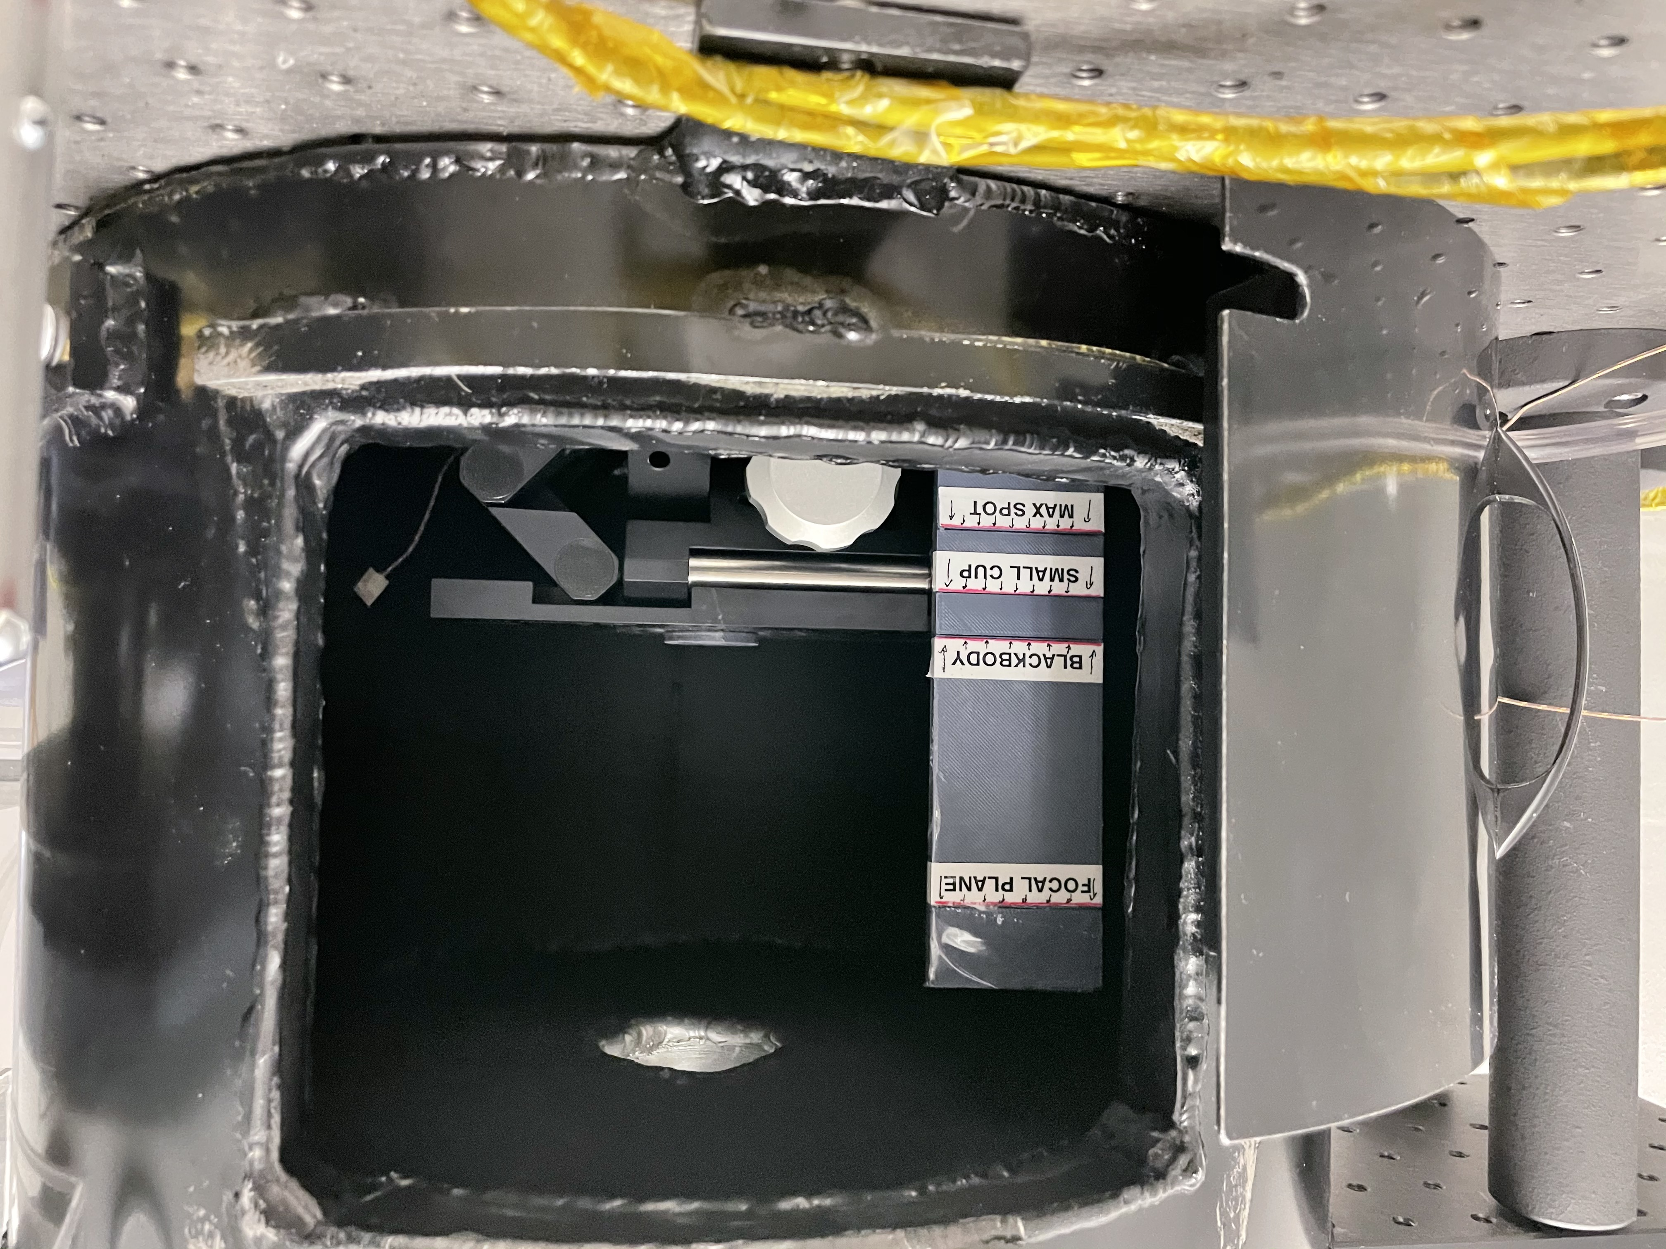

Slide 10
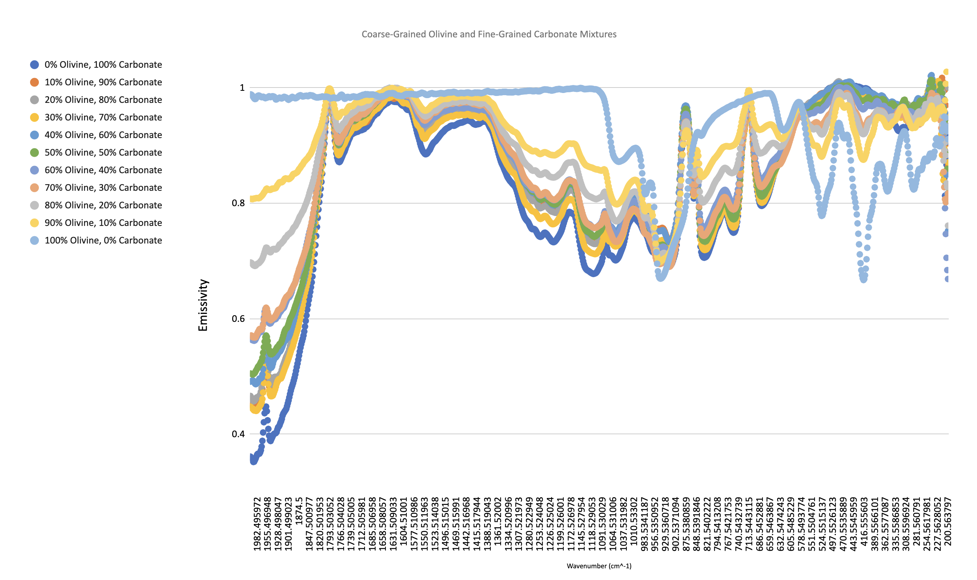

Slide 11
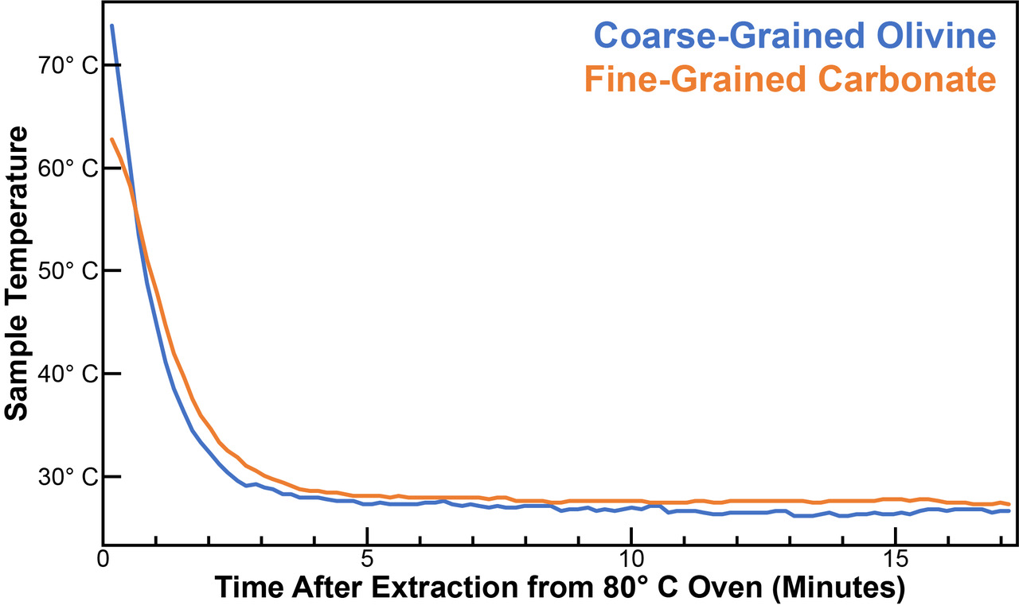
FLIR measurements
Need to write note cards

Slide 12
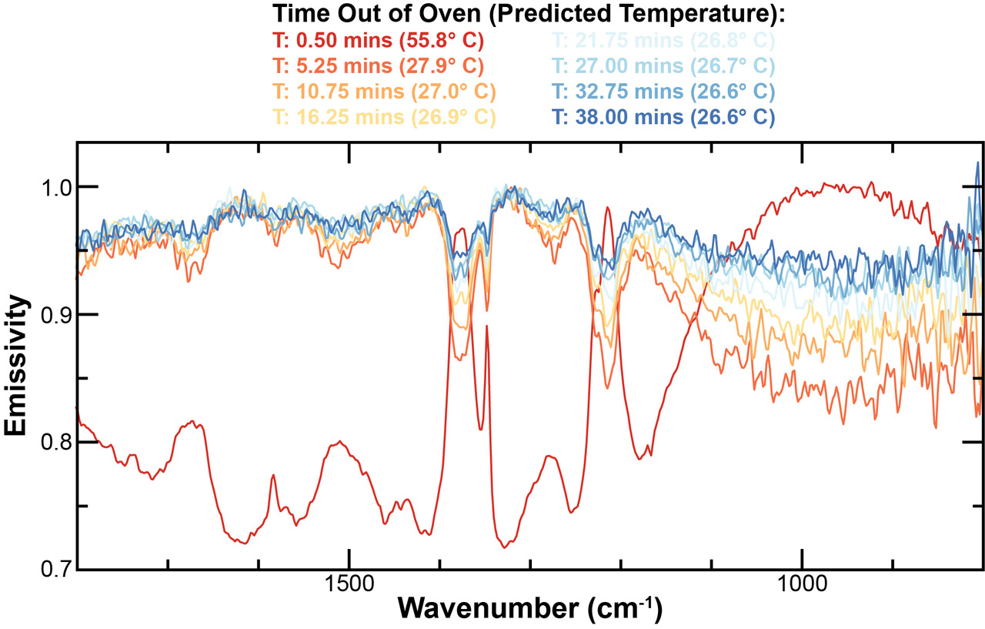
FTIR with FLIR measurements

Slide 13
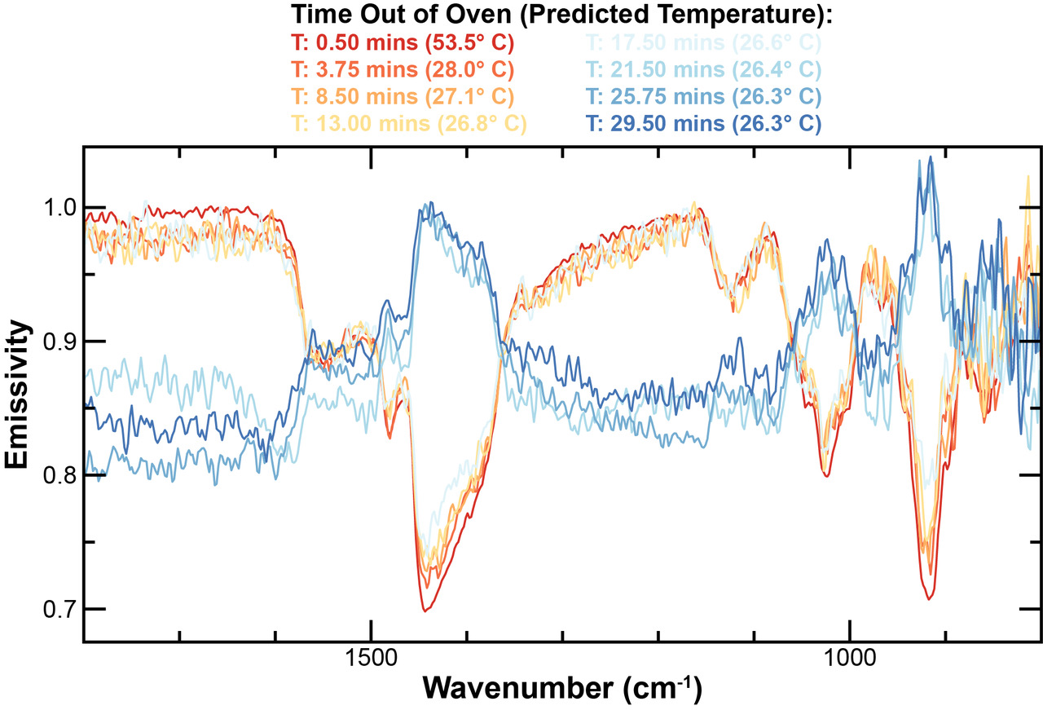

Slide 14
What’s Next
Cementation the samples using salts and rerun tests
Compare Perseverance Rover data and satellite data to results

Slide 15
Questions?

